Slide 1
Functions
Group Functions
Single-Row Functions

Slide 2
Single-Row Functions
Using Single-Row Functions to Customize Output
Various types of functions available in SQL
Use character, number, and date functions in SELECT statements
Using Conversion Functions and Conditional Expressions
Various types of conversion functions available in SQL
Use the TO_CHAR, TO_NUMBER, and TO_DATE conversion functions
Apply conditional expressions in a SELECT statement

Slide 3
Oracle Functions
Functions are programs that take zero or more arguments and return a single value.
Oracle has built-in functions into SQL can be called from SQL statements
Single-row functions
Aggregate functions
Analytical functions and regular expression functions
National-language functions
Object-reference functions
Programmer-defined functions

Slide 4
Single-Row Function
All single-row functions can be incorporated into SQL (and PL/SQL).
You can use these single-row functions in:
SELECT, WHERE, and ORDER BY clauses of SELECT statements:
Example
SELECT first_name, TO_CHAR(hire_date,'Day, DD-Mon-YYYY') FROM employees WHERE UPPER(first_name) LIKE 'AL%' ORDER BY SOUNDEX(first_name);
Can also appear in SET clause of an UPDATE or the VALUES clause of an INSERT and the WHERE clause of a DELETE statements

Slide 5
Functions for NULL
NULL values represent unknown data. Any operation on a NULL results in a NULL
NULL Functions
NVL
NVL2
COALESCE

Slide 6
NVL
NVL function is used to replace a NULL value with a literal value.
Syntax: NVL(x1, x2)
x1 and x2 are expressions
X1 and x2 can be of any datatype
If x1 is null return x2 else return x1

Slide 7
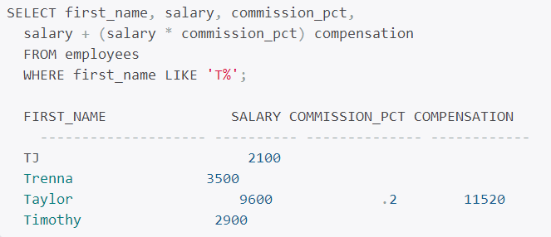
NVL
Example suppose you need to calculate the total compensation in the EMPLOYEES table, which contains SALARY and COMMISSION_PCT columns:
Any issues? why?

Slide 8
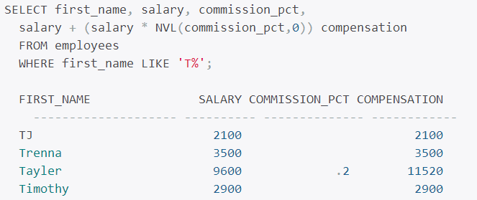
NVL
You see that only Taylor had the total compensation calculated in the SQL; all others have their total compensation as NULL. This is because any operation on NULL results in a NULL.
Use NVL

Slide 9
NVL2
NVL2 takes three arguments, NVL2(x1, x2, x3), where x1, x2, and x3 are expressions
Syntax: NVL2(x1, x2, x3)
If x1 is null return x3 else return x2.
SELECT first_name, salary, commission_pct, NVL2(commission_pct, salary + salary * commission_pct, salary) compensation FROM employees WHERE first_name LIKE 'T%';

Slide 10
COALESCE
COALESCE is variation in NVL
Syntax: COALESCE(exp_list)
For example, COALESCE(x1, x2, x3) would be evaluated as the following:
If x1 is NULL, check x2, or else return x1. Stop.
If x2 is NULL, check x3, or else return x2. Stop.
If x3 is NULL, return NULL, or else return x3. Stop.

Slide 11
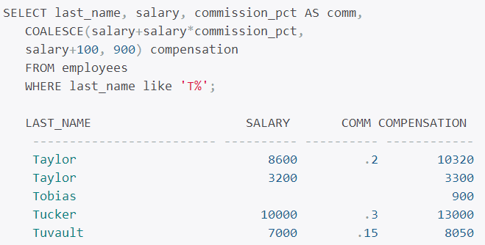
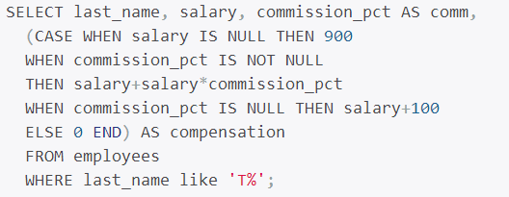
COALESCE
COALESCE Example
Using CASE WHEN

Slide 12
Single-Row Character Functions

Slide 13
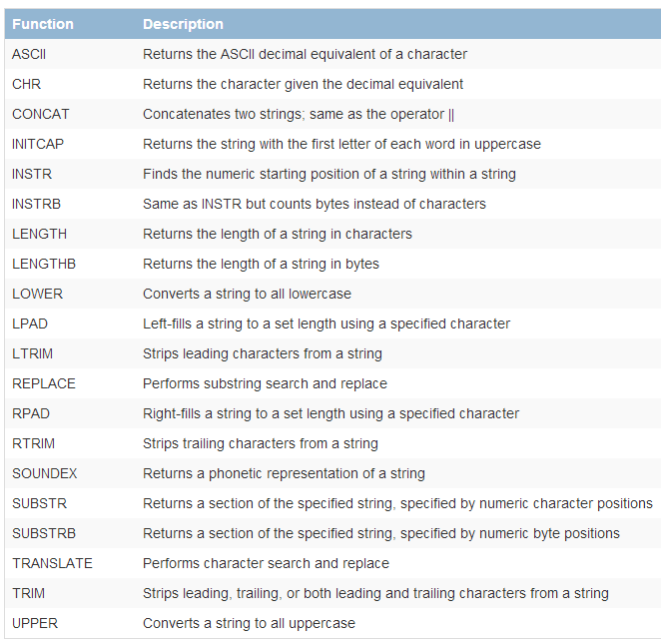
Character Functions

Slide 14
Examples
SELECT ASCII('A') Big_A, ASCII('z') Little_Z, ASCII('AMER') FROM dual;
SELECT CHR(65), CHR(122), CHR(223) FROM dual;
SELECT LPAD(last_name,10) lpad_lname, LPAD(salary,8,'*') lpad_salary FROM employees WHERE last_name like 'J%';

Slide 15
Single-Row Numeric Functions

Slide 16
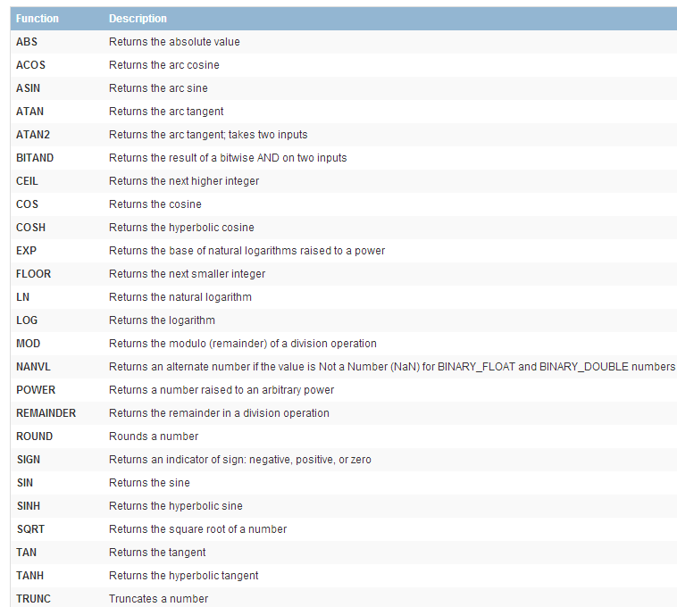
Numeric Functions

Slide 17
Numeric Functions Examples
SELECT ROUND(123.489), ROUND(123.489, 2), ROUND(123.489, -2), ROUND(1275, -2) FROM dual; -------------- ---------------- ----------------- -------------- 123 123.49 100 1300

Slide 18
Single-Row Date Functions

Slide 19
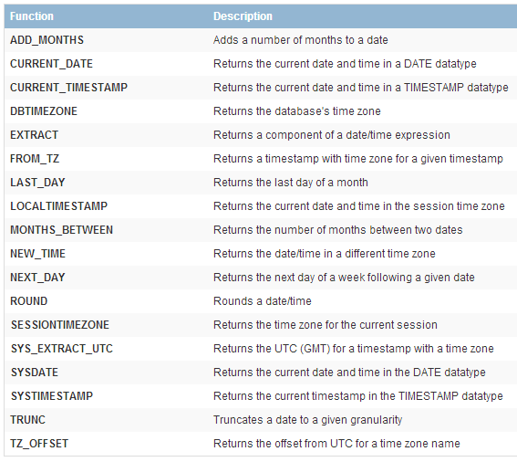
Date Functions

Slide 20
Examples: SYSDATE
SYSDATE takes no arguments and returns the current date and time to the second for the operating-system host where the database resides.
SQL> SELECT SYSDATE FROM dual; SYSDATE --------- 31-MAR-08 SQL> ALTER SESSION SET NLS_DATE_FORMAT='DD-Mon-YYYY HH24:MI:SS'; Session altered. SQL> SELECT SYSDATE FROM dual; SYSDATE -------------------- 31-Mar-2008 10:19:11
ALTER SESSION command will set the implicit conversion mechanism to display date data in the format specified

Slide 21
Examples: SYSTIMESTAMP
TIMESTAMP WITH TIME ZONE for the current database date and time (the time of the host server where the database resides).

Slide 22
Single-Row Conversion Functions

Slide 23
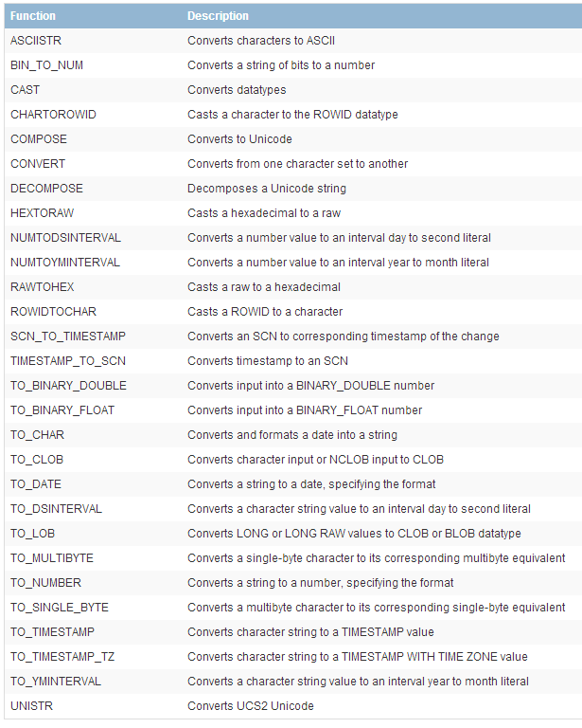
Conversion Functions

Slide 24
Group Functions

Slide 25
Aggregated Data Using the Group Functions
Group functions do not consider NULL values, except the COUNT(*) and GROUPING functions.
Watch out for NULLs
Use DISTINCT or ALL
Oracle defaults to all (counts non unique values)

Slide 26
Example: DISTINCT vs. ALL
SELECT first_name, salary FROM employees WHERE first_name LIKE 'D%' ORDER BY salary; FIRST_NAME SALARY -------------------- ---------- Donald 2600 Douglas 2600 Diana 4200 David 4800 David 6800 Daniel 9000 David 9500 Danielle 9500 Den 11000

Slide 27
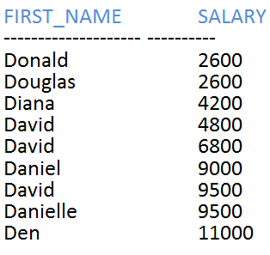
Example: DISTINCT vs. ALL
SELECT COUNT(salary) cnt_nu, COUNT(DISTINCT salary) cnt_uq, SUM(salary) sum_nu, SUM(DISTINCT salary) sum_uq FROM employees WHERE first_name LIKE 'D%'; CNT_NU CNT_UQ SUM_NU SUM_UQ ---------- ---------- ---------- ---------- ---------- ---- 9 7 60000 47900

Slide 28
COUNT example
SELECT COUNT(*) FROM employees; COUNT(*) ---------- 107
SELECT department_id, COUNT(*) "#Employees" FROM employees; SELECT department_id, COUNT(*) "#Employees“
What is the output??????????????

Slide 29
GROUP BY Example
If you include a group function in the SELECT clause, you cannot select individual results unless you use the GROUP BY clause
SELECT department_id, COUNT(*) "#Employees" FROM employees GROUP BY department_id; DEPARTMENT_ID #Employees ------------- ---------- -------- -------- 100 6 30 6 1 20 2 70 1 90 3 110 2 50 45 40 1 80 34 10 1 60 5

Slide 30
Column Alias
SELECT department_id, COUNT(*) "#Employees" FROM employees GROUP BY department_id ORDER BY 2 DESC, department_id;
SELECT department_id, COUNT(*) "#Employees" FROM employees GROUP BY 1; SELECT department_id, COUNT(*) "#Employees“
Output???????

Slide 31
GROUP BY
The GROUP BY column does not have to be in the SELECT clause.
SELECT AVG(salary) average_salary FROM employees GROUP BY department_id;

Slide 32
GROUP BY Notes
If you have more than one column in the GROUP BY clause, Oracle creates groups within groups.
The order of columns in the GROUP BY clause determines the grouping.
Multiple columns in the GROUP BY clause are required when you have more than one nonaggregate column in the SELECT clause.

Slide 33
Group Within Group
The SQL shows the number of different jobs within each department:
SELECT department_id, job_id, COUNT(*) FROM employees GROUP BY department_id, job_id ORDER BY 1, 2;

Slide 34
Ordering
The GROUP BY clause groups data, but Oracle does not guarantee the order of the result set by the grouping order. To order the data in any specific order, you must use the ORDER BY clause.

Slide 35
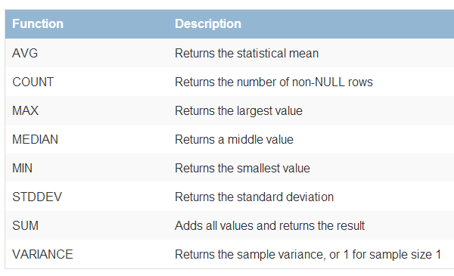
Group-Function Overview

Slide 36
MEDIAN Example
SELECT job_id,
MEDIAN(Salary) median, AVG(salary) average, MIN(salary) low_sal, MAX(salary) high_sal FROM hr.employees WHERE job_id like '%CLERK' GROUP BY job_id;

Slide 37
Nesting Single-Row Functions with Group Functions
SELECT deptno, GREATEST( COUNT(DISTINCT job), COUNT(DISTINCT mgr)) cnt, COUNT(DISTINCT job) jobs, COUNT(DISTINCT mgr) mgrs FROM scott.emp GROUP BY deptno; DEPTNO CNT JOBS MGRS ---------- ---------- ---------- ---------- ---------- ---------- ---------- 10 3 3 2 20 4 3 4 30 3 3 2

Slide 38
Nesting Group Functions
SELECT MAX(COUNT (DISTINCT job_id)) FROM employees GROUP BY department_id; MAX(COUNT(DISTINCTJOB_ID)) -------------------------- 3
Group functions can be nested only one level. If you try to nest more than one level of nested group functions, you will encounter an error

Slide 39
STDDEV
SELECT department_id, COUNT(salary) emp_cnt, MIN(salary) minimum, MAX(salary) maximum, AVG(salary) mean, STDDEV(salary) deviation FROM employees GROUP BY department_id ORDER BY department_id;

Slide 40
Next Time
Joins and Subqueries
Set Operators

